Slide 1
“Gothic”
ARTH 312
Fall 2019

Slide 2
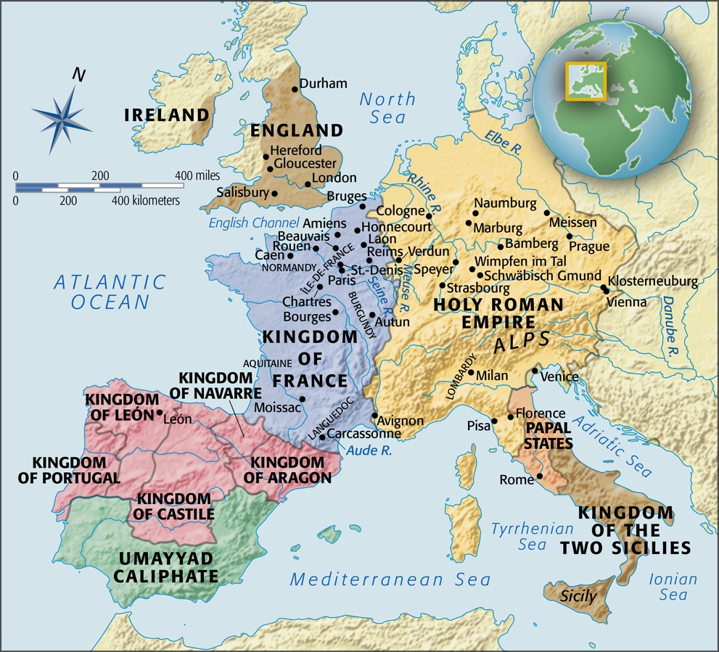
Île-de-France

Slide 3
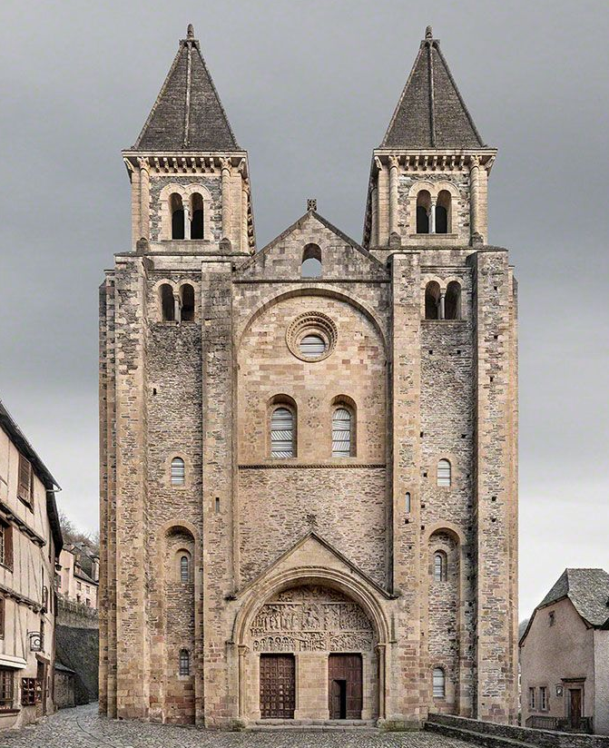
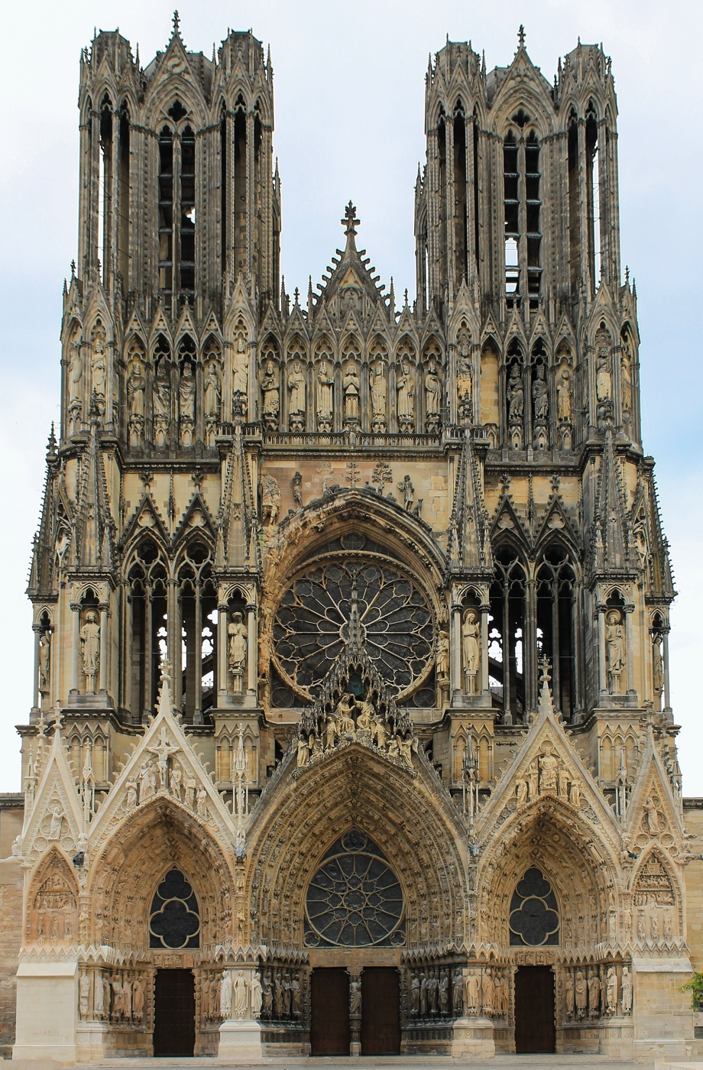
Sainte-Foy, Conques, France, mid-11th to early 12th century.
Reims Cathedral, Reims, France, ca. 1211-1290.
Notes:
Reims Cathedral’s façade reveals High Gothic architect’s desire to replace heavy masonry with intricately framed voids.

Slide 4
opus francigenum*
stone and glass images of the City of God, the Heavenly Jerusalem
dedicated to the Virgin Mary
the site of all French kings’ coronations since 496
lancets
stained-glass rose window
Jean d’Orbais, Jean le Loup, Gaucher de Reims, and Bernard de Soissons, Reims Cathedral, Reims, France, ca. 1211-1290.
Notes:
multigeneration construction campaign
prestige
an era of peace and widespread economic prosperity, deep spirituality, and extraordinary technological innovation

Slide 5
Lorenzo Ghiberti (1378-1455), Commentaries: a period of decline
Giorgio Vasari (1511-1574), Introduction to the Three Arts of Design (1550): “monstrous and barbarous”
Jean d’Orbais, Jean le Loup, Gaucher de Reims, and Bernard de Soissons, Reims Cathedral, Reims, France, ca. 1211-1290.

Slide 6
Notes:
Vassari attributed late medieval art and architecture to the Goths, whom he regarded as responsible for both the downfall of Rome and the dissolution of the classical style in art and architecture.

Slide 7
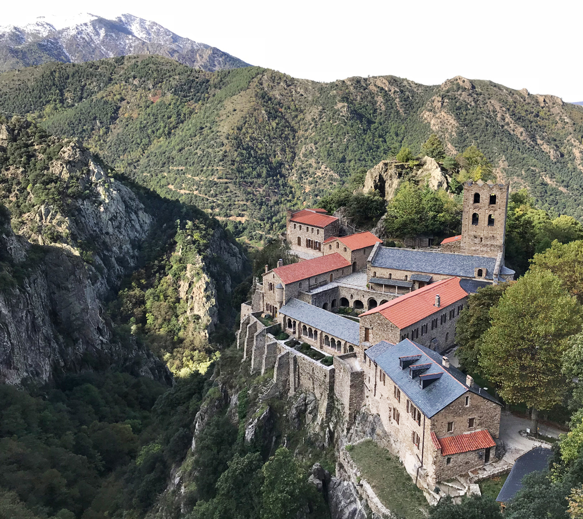
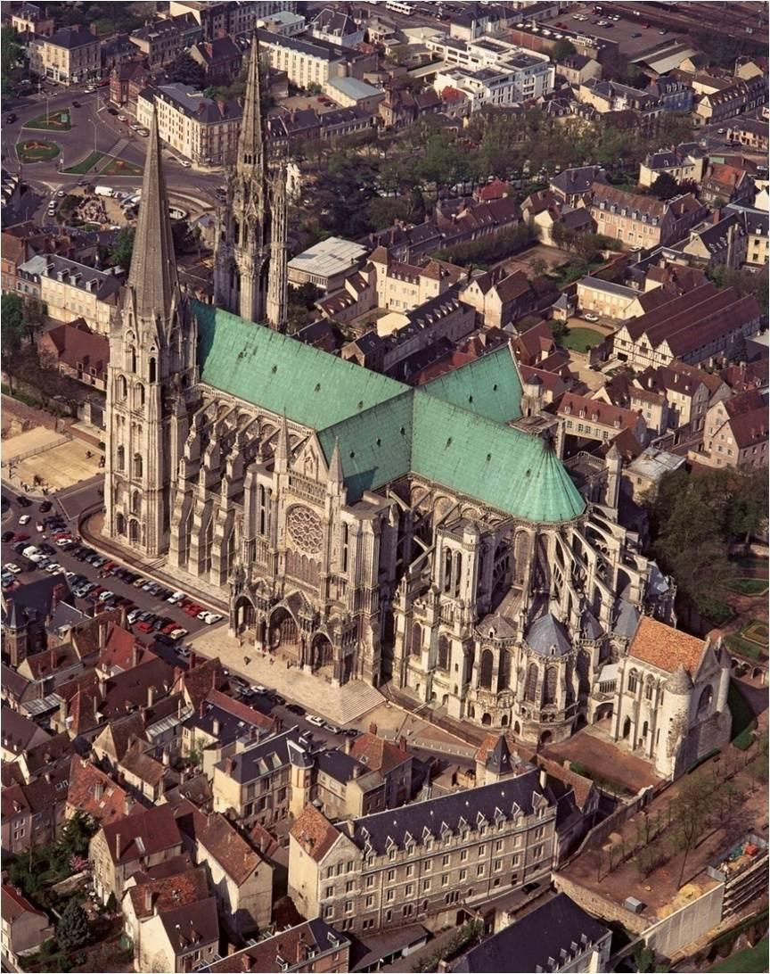
Île-de-France
Chartres Cathedral, Chartres, France, as rebuilt after 1194.
Saint Martin-du-Cantigou. French Pyrenees, 1001-26.
Notes:
from monasteries in the countryside to rapidly expanding cities

Slide 8
guilds*
universities
vernacular literature
Notes:
University of Bologna (1088)
Although the papacy was at the height of its power, and Christian knights still waged Crusades against the Muslims, the independent nations of modern Europe were beginning to take shape.

